Slide 1
Welcome to ALM/Quality Center Web Runner We will start shortly…

Slide 2
ALM/Quality Center Web Runner
MF SaaS Technical Solutions Consultant
Notes:
Hello and welcome to another Micro Focus Webinar
My name is Thanh Phan.
Today topic is on ALM Quality Center Web Runner
The presentation will take around 20 minutes follow by a 10 minutes Q&A session.
I will mute everybody for during the presentation and will open up the mic afterward.

Slide 3
Agenda
Web Runner Introduction
Test Plan Module (NEW in ALM/Quality Center 16) – Test Authoring
Test Lab Module - Manual and Automated Tests Execution
Defects Module – Defect Edit and Submission
Settings - Defect and Run Settings
Cross Project Customization
Admin Page – Enable/Disable Modules
License Consumption
9. Q&A
2

Slide 4
Web Runner Intro
A new, lightweight, and pure web-based tool.
Web Runner is a test authoring and execution tool.
It enables you to create manual tests, run both manual and automation tests, submit and edit defects and viewing the dashboard from a Web browser, without the need to download the ALM client.
It also offers a different set of forms and rules to enforce your process without using the ALM workflow
After creating your tests and completing your test runs, the test results along with any submitted defects are automatically saved to ALM

Slide 5
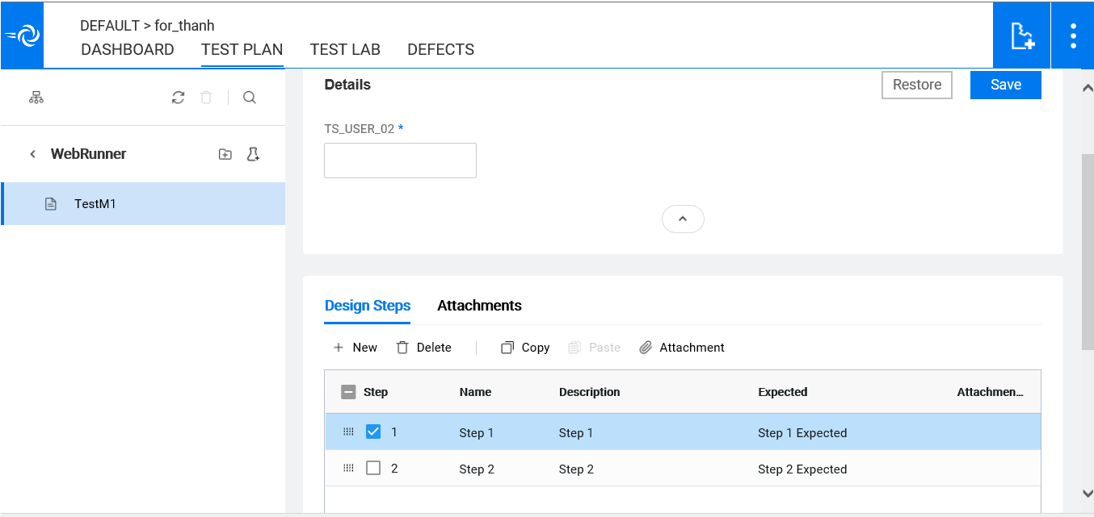
Test Plan Module - Test Authoring (NEW in ALM/Quality Center 16)
Folder
Add/Delete/Duplicate/Rename
Manual Tests
Add/Delete/Duplicate/Rename
Edit required fields in Details pane
Design Steps
Add/Copy/Delete/Modify/Paste
Edit required fields
Attachments
Add/Delete (for both Tests and Design Steps)

Slide 6
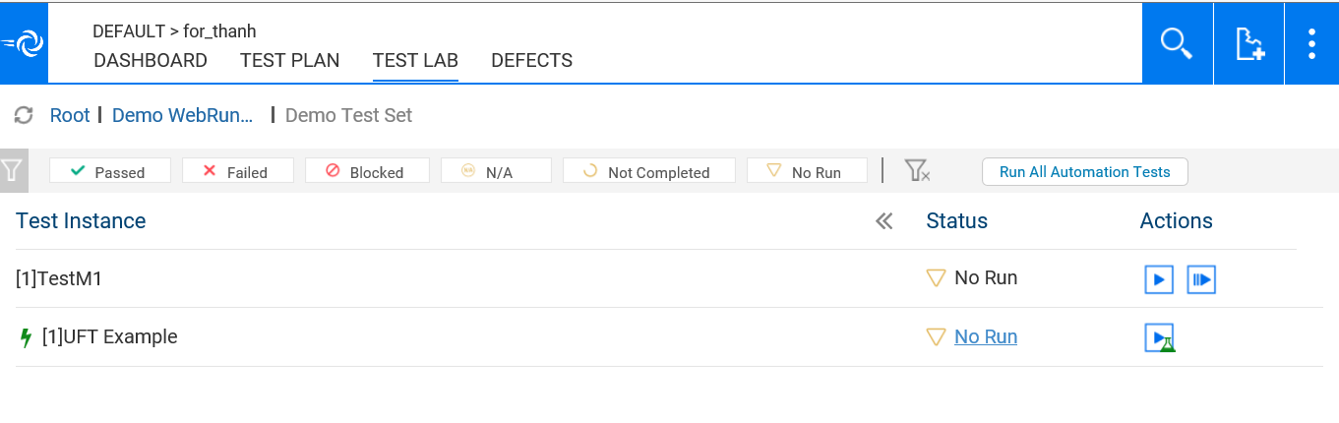

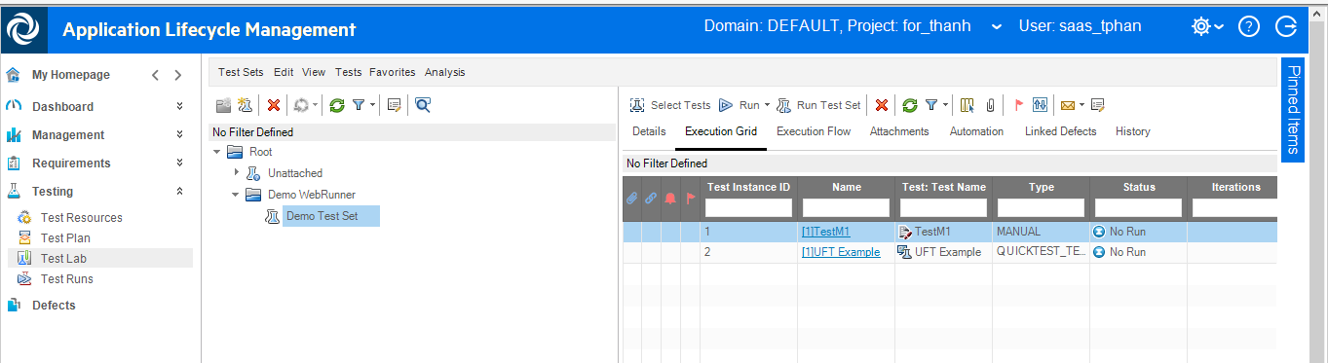
Test Lab Module - Test Sets Execution Setup
Allow for execution of manual and automated tests

Slide 7
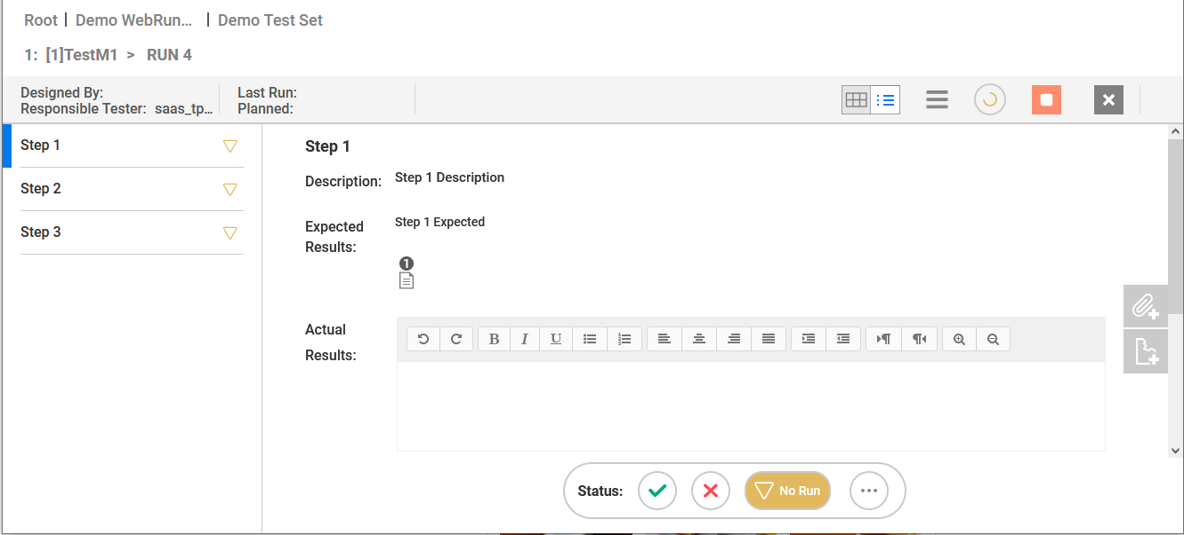

Test Lab Module – Manual Test Run Detail View
Manual Test Run Detail View

Slide 8
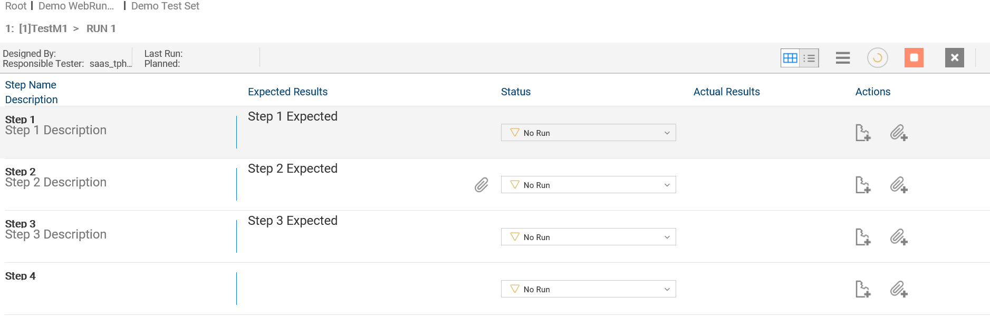
Test Lab Module – Manual Test Run Grid View
Manual Test Grid View

Slide 9
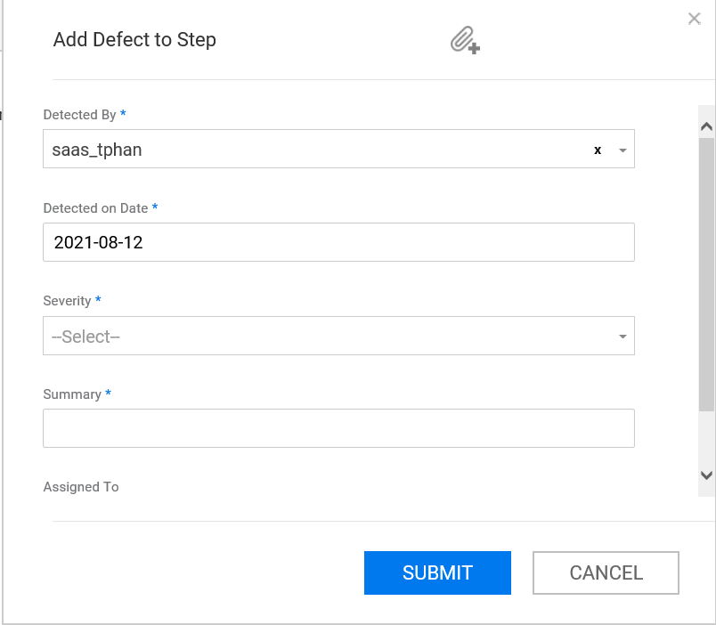

Test Lab Module – Defect Submission Upon Failed Step
Submit new Defect during test execution

Slide 10
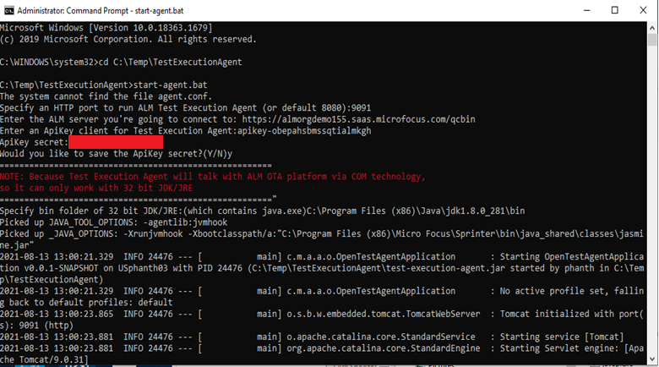
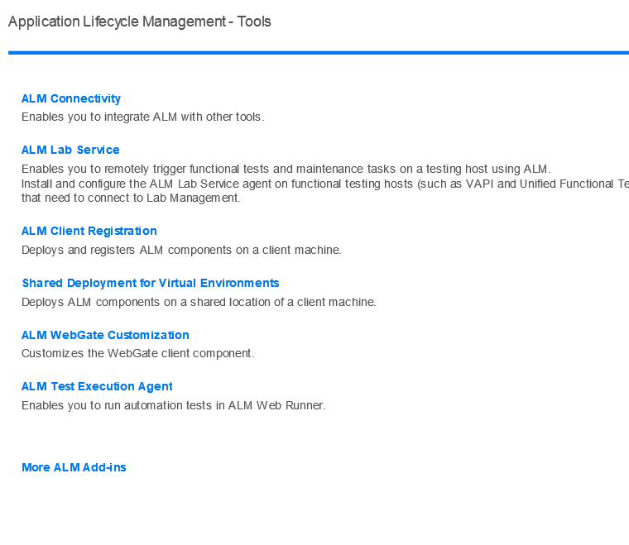
Test Lab Module – Automation Agent Setup
Download the ALM Tests Execution Agent
Client Registration
Start the agent
Provide connection information
Server URL
API Key + Secret
32-bit JDK 8 location

Slide 11
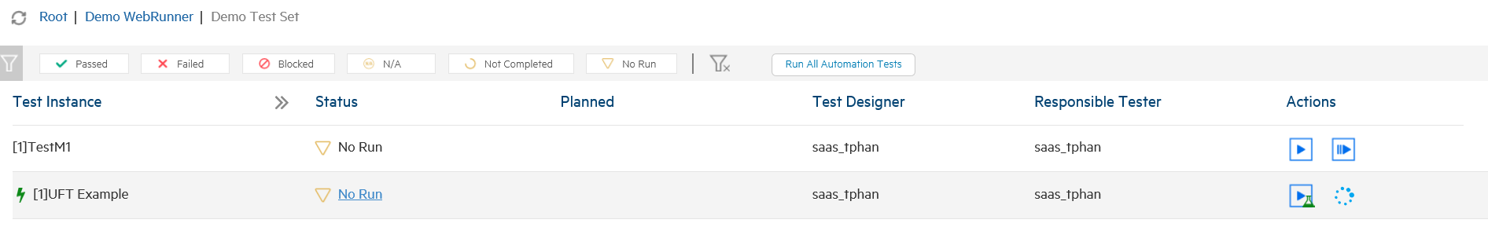
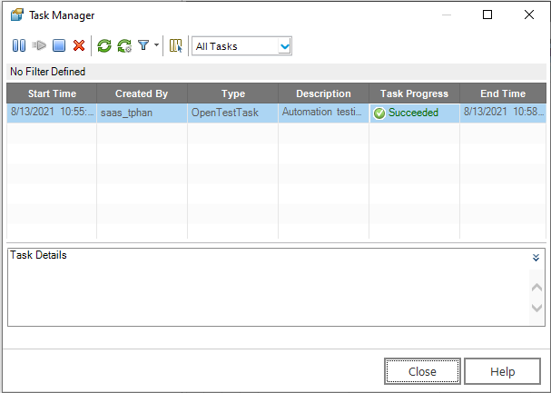
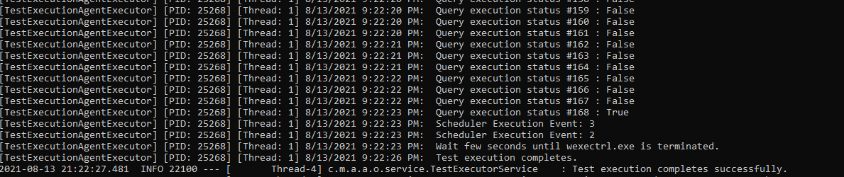
Test Lab Module – Automation Tests Execution
Automated Test Type Supported depends on testing tool installed on the machine.
No Testing Tool: VAPI-XP
UFT : QUICKTEST_TEST, VAPI-XP, BUSINESS-PROCESS, FLOW, SERVICE-TEST

Slide 12
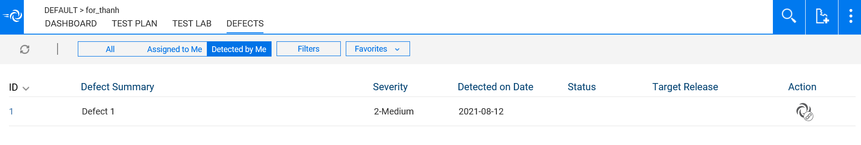

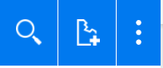
Defects Module
Displays Defects in ALM.
You can use the filter at the top to
All
Assigned to Me
Detected By Me
Filters
Favorites

Slide 13
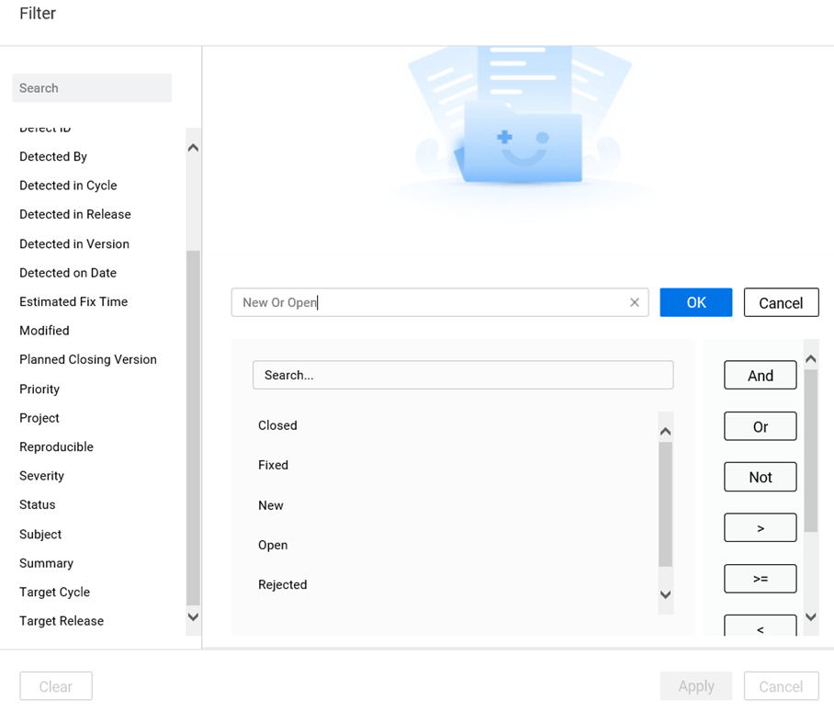
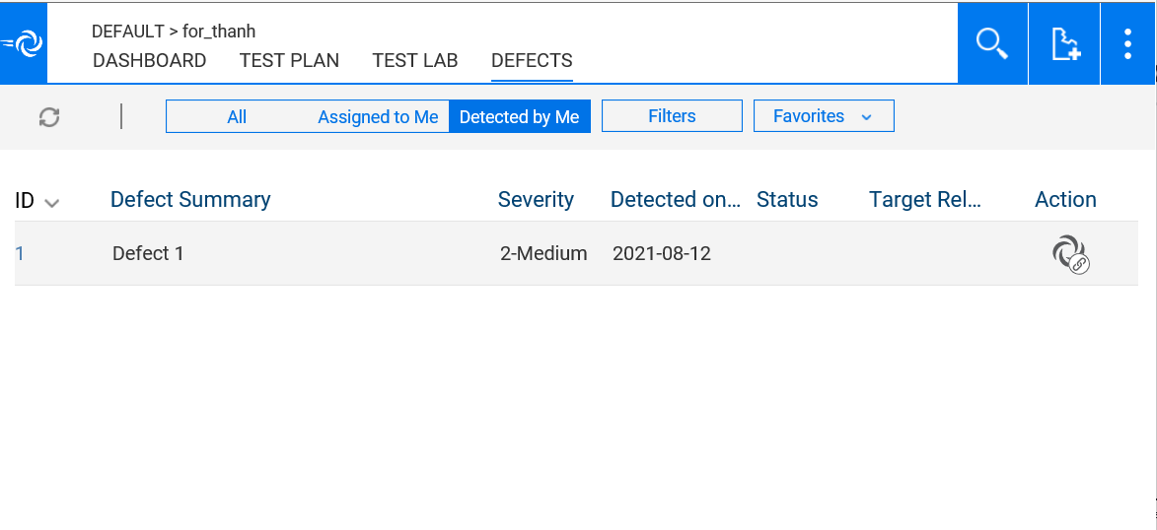
Defects Module – Applying Custom Filter (NEW in ALM/Quality Center 16)
Fully Functional filter is now supported for Defect module

Slide 14
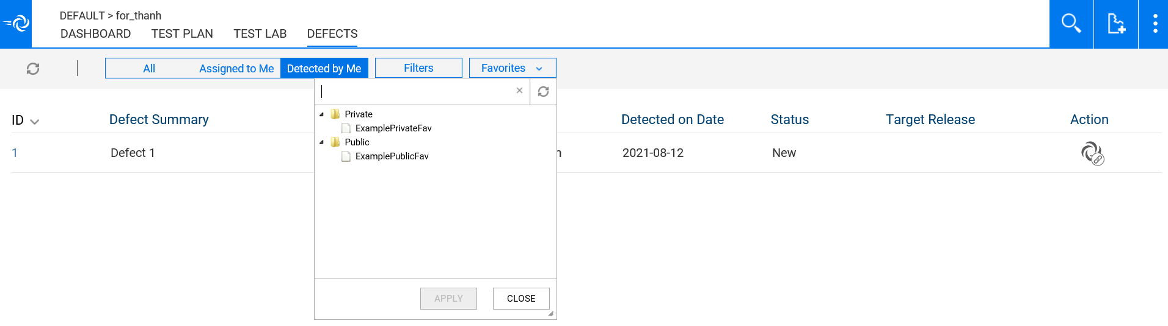
Defects Module – Applying Favorite
Public and Private Favorites defined in ALM can be applied in the Web Runner

Slide 15
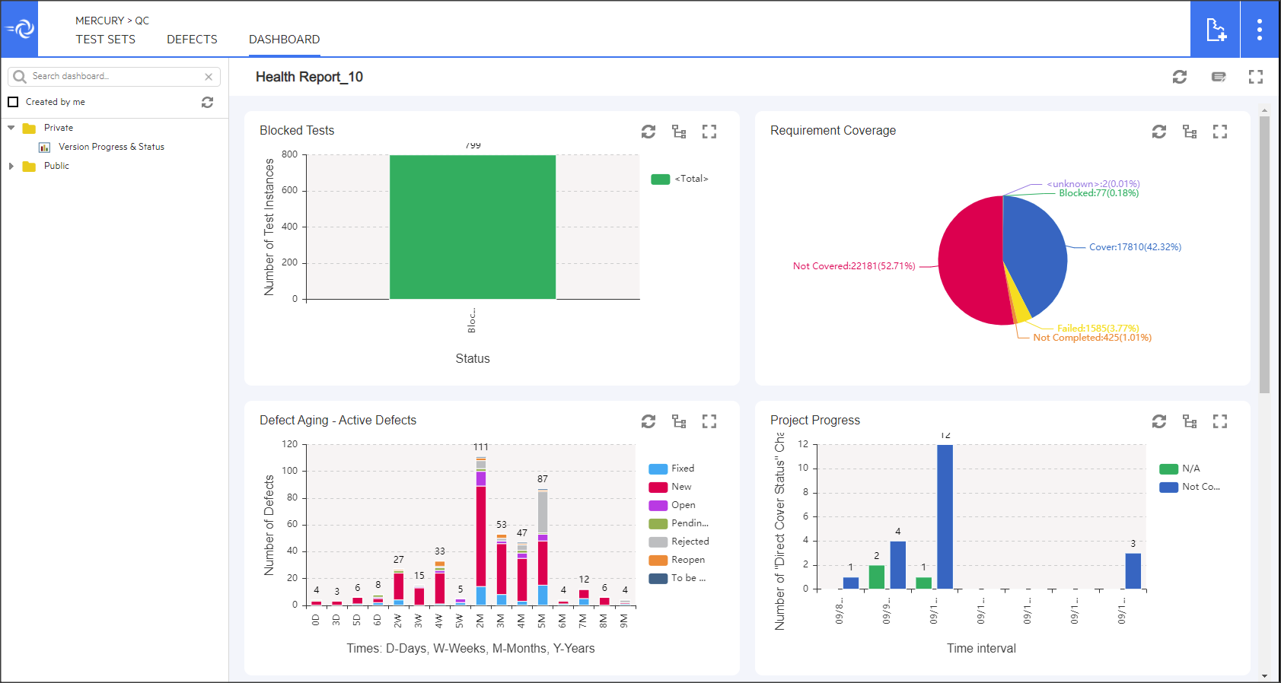
Dashboard Module
See dashboards from ALM in WebRunner

Slide 16
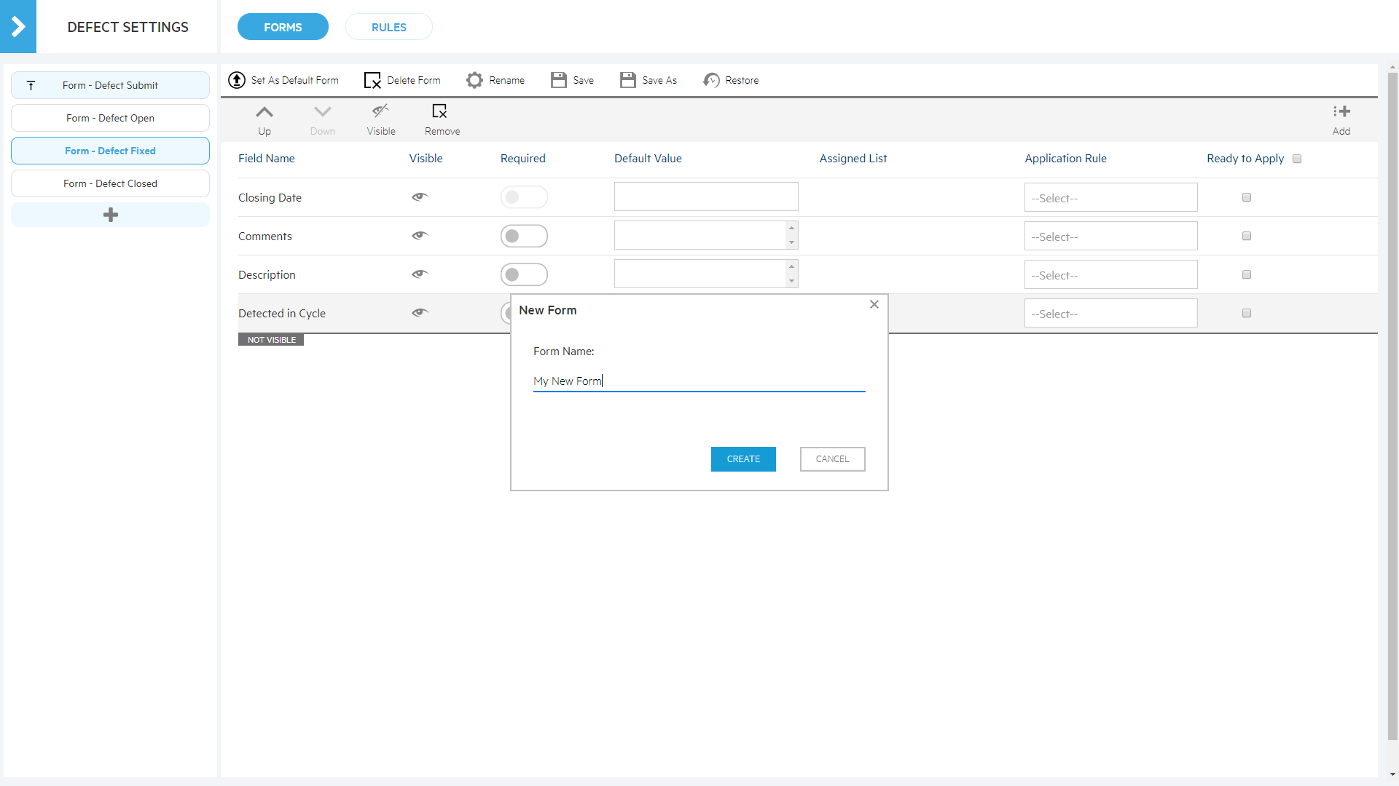
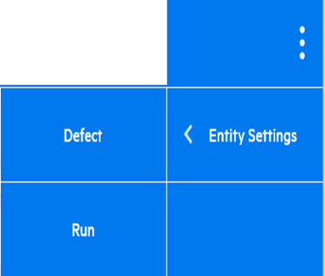
Defect Settings – Defect Forms
Multiple forms can be created in the defect module
Notes:
As a Project Administrator, you can customize the Defect and Run settings.
To get to the Defect Settings you go to Ellipse -> Settings -> Defect
However, this option is only available if you are a Project Admin
In the defect settings, you will see Forms and Rules tabs. We will go over Rules tab in the next slide.
In the Forms Defect Settings, you can create multiple forms for the Defect module
To add a new form, you want to click on the + button here.
Enter a name for your form and click Create.
You can now customize the form by adding additional fields and set properties.
For each field, you can set the Visibility and Required properties
You can also set default value for each field
And do field order
For template, you will see also Application Rule and Ready to Apply columns.
In the Application Rule, you can set select either Enforced or Recommend.
Enforced here means the field must be set and cannot be changed in linked project.
Recommend means it change be changed.
Ready for Apply checkbox– Enabling the checkbox means that the field will be available when you apply customzition.
In this screen capture here, I want to have created multiple forms… in fact, I have one for each defect status.
- So I have a Defect Submission
a Defect Open form
And etc….
Each form can have different list of fields with different field properties depending on my requirements
And as a last step, I can selected one form, Form- Defect Submit, as my default form
This default form will be used if there is no defect rules or when no rule fits.

Slide 17
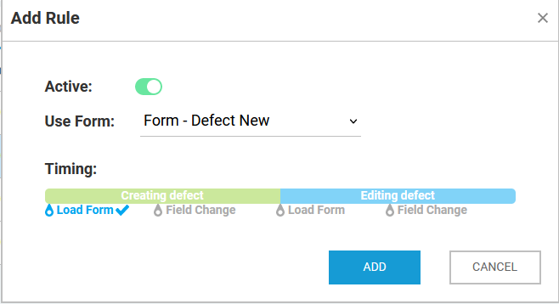
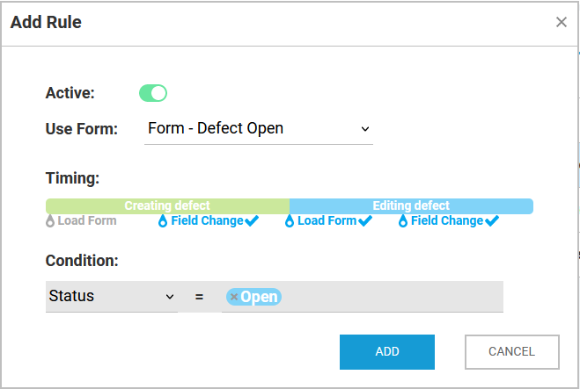
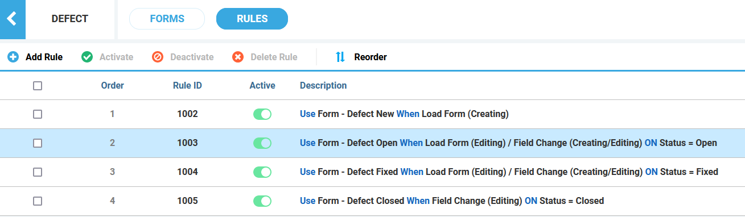

Defect Settings – Transition Rules
Transition Rules can be created to determine when each form will be used

Slide 18
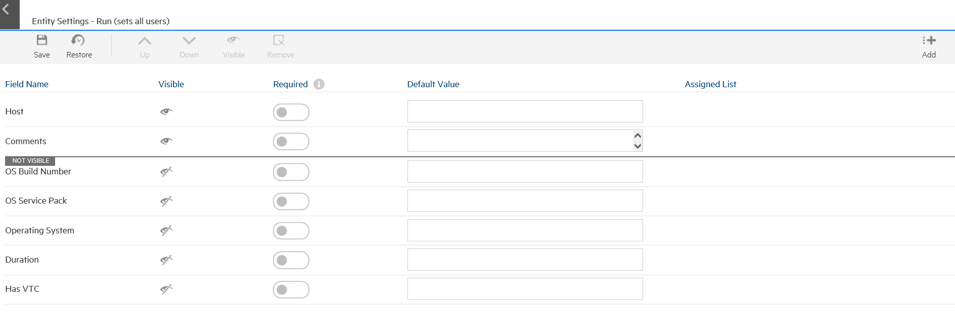
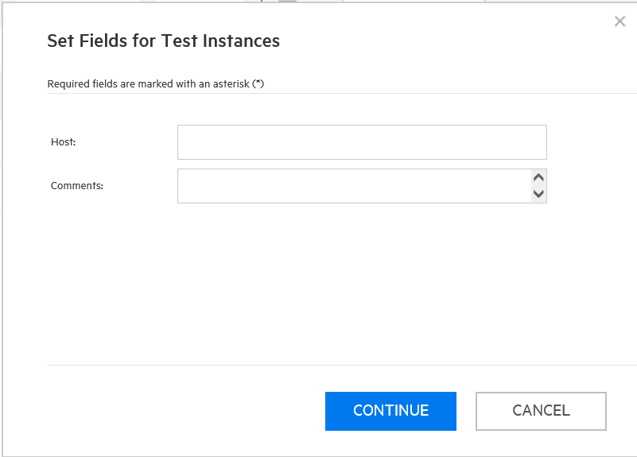

Run Settings
Customize fields to be display when running manual tests

Slide 19
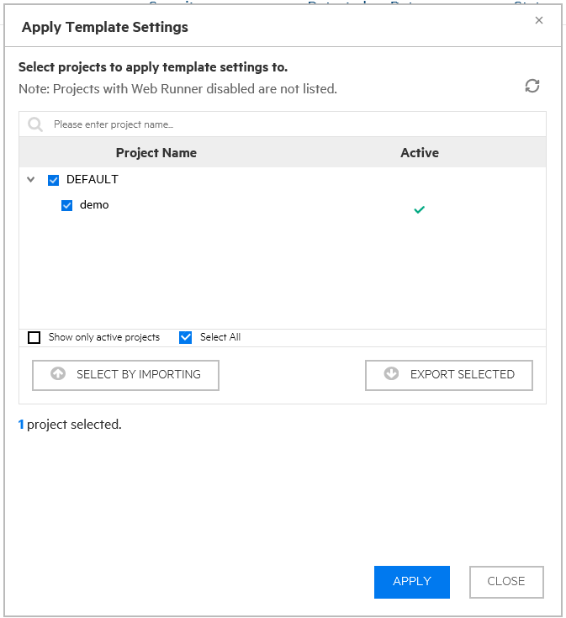
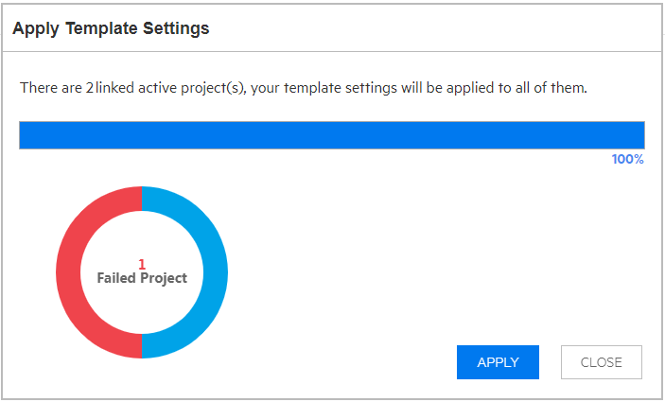
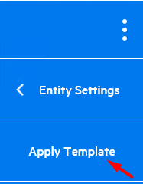
Web Runner – Cross Project Customization
When ready apply settings to linked projects *ALM edition only

Slide 20
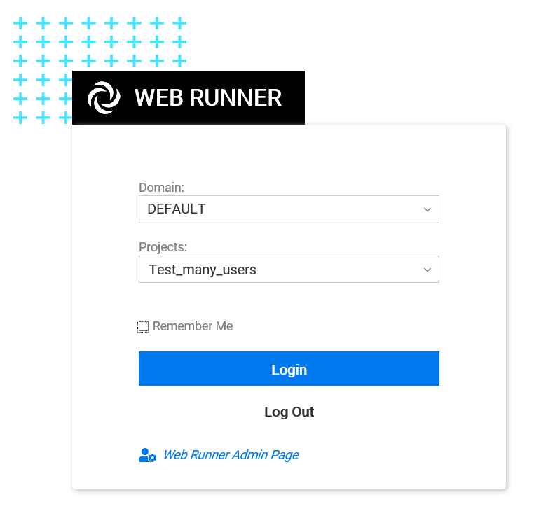
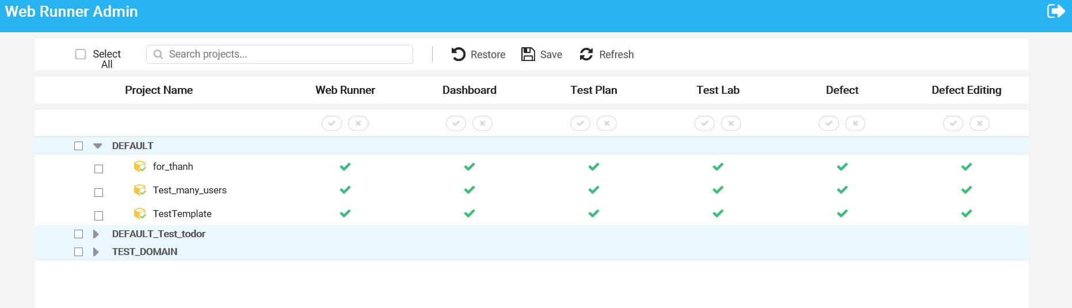
Web Runner – Admin Page
Enable/Disable Web Runner
per module per Project

Slide 21
Web Runner – License consumption
WebRunner - Web Runner Client. Full ALM License is consumed.

Slide 22

Inform Slides (Details On Slide 2)

Slide 23
Questions & Answers

Slide 24
www.microfocus.com

